Slide 1
Trigonometry for Animation

Slide 2
Vectors
For people who have seen Despicable Me you should be aware that a vector has both magnitude and direction
What that means is that an object in motion has velocity/acceleration and direction
For example in GPE pen.south(10);

Slide 3
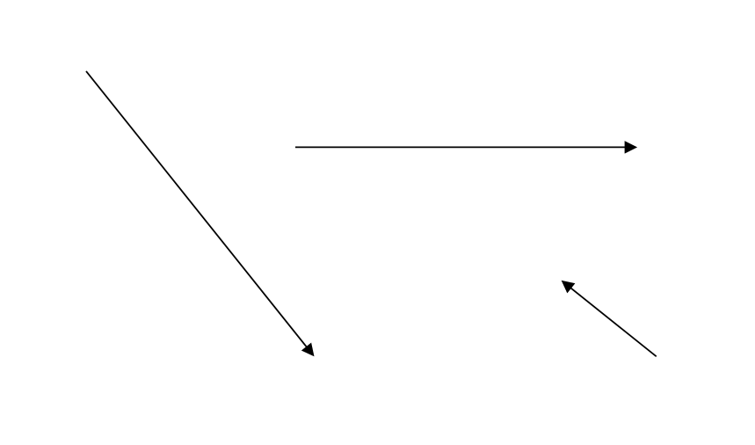
Here are Some Vectors
If this was 1 second of travel which object is moving the fastest?

Slide 4

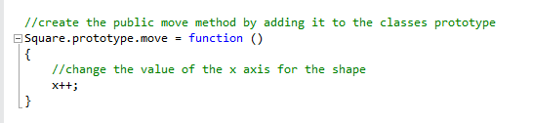
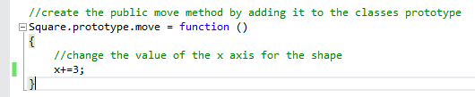
Look at the Box Example
Directions is zero radians

Slide 5
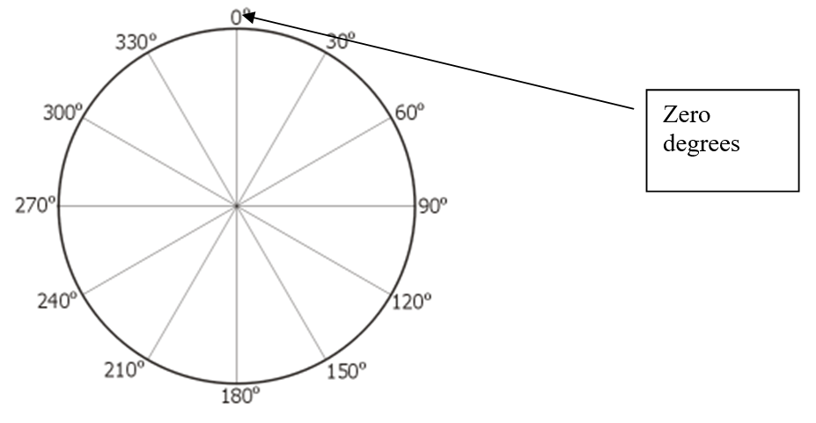
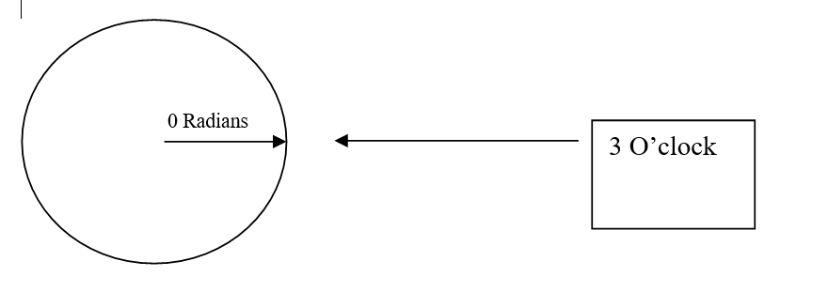
Radians v Degrees

Slide 6
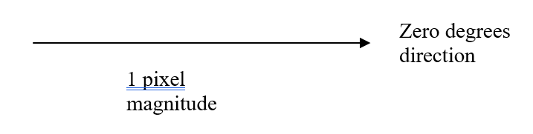
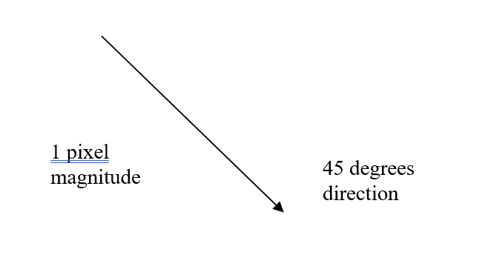
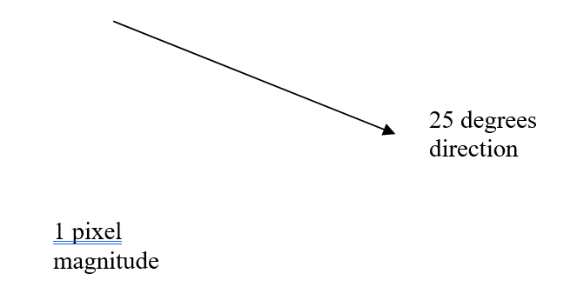
Working with Vectors
Horizontal or vertical – easy e.g. x++
45% - easy e.g. x++ and y++
But how do you calculate this or other weird and wonderful angles?

Slide 7
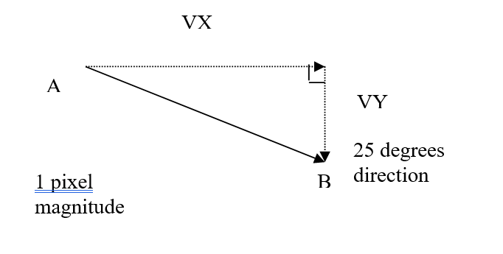
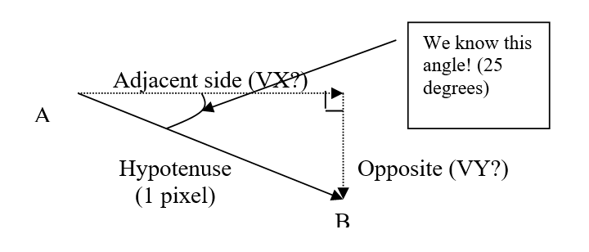
Basic Trigonometry
Fortunately right angled triangles are predictable
Sine=Length of the Opposite Side / Hypotenuse
Cosine=Length of the Adjacent Side / Hypotenuse
Tangent=Length of the Opposite Side / Adjacent (We wont need this formula)

Slide 8
Re-arrange the formulas
Speed of travel VX (length of the adjacent side) = Cosine * Hypotenuse
Speed of travel VY (length of the opposite side) = Sine * Hypotenuse

Slide 9
Fill in the values that we know
Speed of travel VX (length of the adjacent side) = Cosine * 1 pixel
Speed of travel VY (length of the opposite side) = Sine * 1 pixel

Slide 10
Convert the Number of Degrees to Radians
Radians = Degrees * PI / 180
Radians = 25 * PI / 180
Radians = 0.4363323129985824

Slide 11
Plug the Radians in to the formulas
Speed of travel VX (length of the adjacent side) = Cosine(0.4363323129985824) * 1 pixel
Speed of travel VY (length of the opposite side) = Sine(0.4363323129985824) * 1 pixel
Gives us…
0.9063077870366499 = Cosine(0.4363323129985824) * 1
0.42261826174069944 = Sine(0.4363323129985824) * 1
Resulting in
VX = 0.9063077870366499 pixels per frame
VY = 0.42261826174069944 pixels per frame

Slide 12
Finally
The good news is the computer will perform the calculation
Appreciation is important
Look at the example for Arrow and Box + the supporting notes

